Slide 1
24 maart 2018 #GIB2018
Gijs in ‘t Veld
Voorzitter/Chairman MIUG

Slide 2

Thank you for sponsoring and hosting!

Slide 3


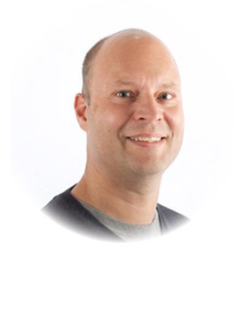
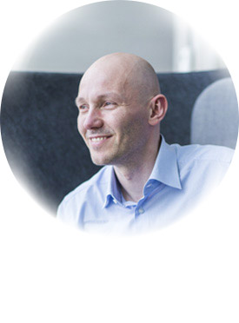
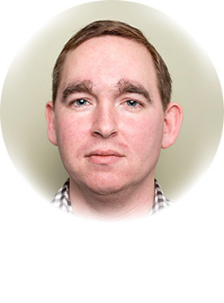
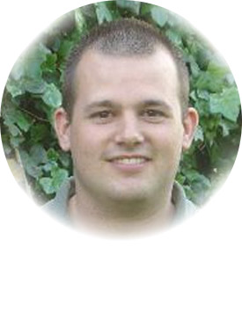
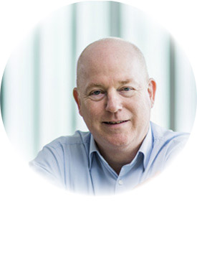
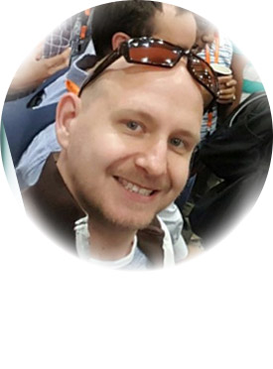
Global Organizers
Martin Abbott
Glenn Colpaert
Steef-Jan Wiggers
Tomasso Groenendijk
Eldert Grootenboer
Sven Van den brande
Gijs in ‘t Veld
Rob Fox

Slide 4

From our sponsor

Slide 5


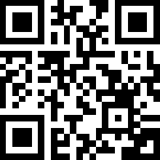
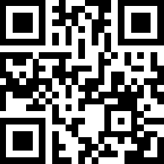
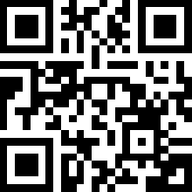
From our sponsor
Atomic Scope Gold 1 Month Free
https://bit.ly/2IPOjr8
BizTalk360 Platinum 1 Month Free
https://bit.ly/2FZSKSB
ServiceBus360 Gold 2 Months Free
https://bit.ly/2GiRGJ4

Slide 6
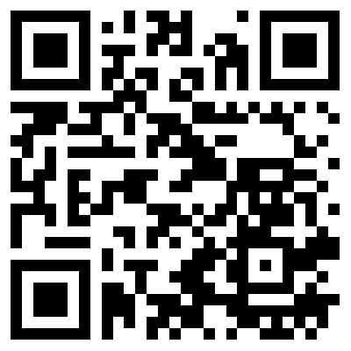
BizTalk Server Open Source Community
https://github.com/BizTalkCommunity

Slide 7
Global Integration Bootcamp 2018 - Agenda
9:00 Welkom - Gijs in 't Veld
9:15 Integrating life with cognitive services - Eldert Grootenboer
10:00 Labs
11:15 Azure Data Factory - Jerrold Stolk
12:00 Lunch en labs
14:00 Industrial Internet of Things – Eldert Grootenboer
14:45 Labs
16:00 Redis Cache/CosmosDB to improve API Perf - Tomasso Groenendijk
17:00 Hapjes en drankje
Twitter #GIB2018

Slide 8
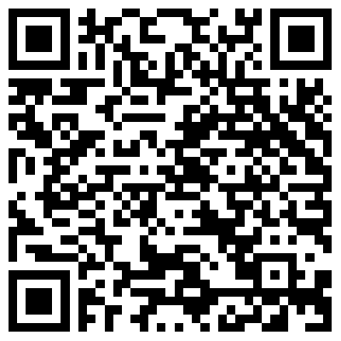
Labs
https://github.com/GlobalIntegrationBootcamp/GlobalIntegrationBootcamp/tree/master/2018/Labs

Slide 9
#MIUGNL @MIUGNL MIUG.NL
Gijs in ‘t Veld @gintveld
Steef-Jan Wiggers @steefjan
Tomasso Groenendijk @tlagroenendijk
Lex Hegt @lexhegt
Roger Busser

Slide 10
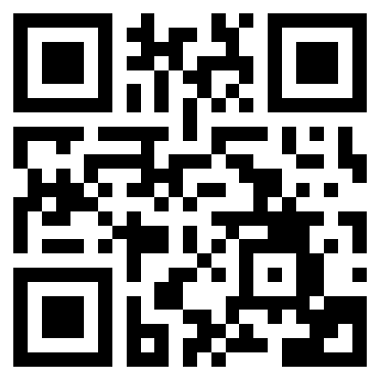
Please fill out the survey!
http://bit.ly/2ptjRdL

